Slide 1

AI-Powered Competitor Price Tracker And Optimizer
Presented by:
1. Kapish Kumar Srivastava(231B155)
2. Abhishek Bhade(231B006)
3. Shevya Singh(231B310)
Project guide : prof. Sanjay Garg
Project number : SG9

Slide 2
AI-Powered Price Optimization: A Competitive Edge for Ecommerce
Pricing is key to success in today’s online market.
Our AI tool helps e-commerce brands set smarter prices and stay competitive.
We’ll share our approach, key features, and real benefits for retailers and customers.

Slide 3
Problem Statement
Problem: Local electronics retailers are losing customers who check prices on their phones while in the store. This is called showrooming.
The Cause: Pricing Asymmetry. Online retailers use dynamic, hourly pricing based on algorithms, while local shops use static pricing.
The Consequence: Retailers cannot determine the actual "price to beat" without manual effort, leading to lost sales and sacrificed profit margins.

Slide 4
Motivation
Price drives success in e-commerce → Customers want the best deals, and retailers must stay competitive.
Manual tracking fails → Slow, error-prone, and not scalable for today’s fast-changing market.
AI + Automation is the answer → Customers → Easily find the best prices. Retailers → Dynamically optimize pricing to maximize profit.
Relevance → Growing demand for AI-driven pricing makes this solution timely and impactful.

Slide 5
Existing Limitations & Our Goal
Manual Checking: Inefficient, outdated instantly, and impossible for large inventories.
Enterprise Platforms: Too expensive and complex for a small shop owner.
Our Goal: To provide a single, actionable AI Competitive Price Guideline that is reliable, real-time, and easy for the retailer to use.

Slide 6
Project Feasibility
Technical Feasibility
Economic Feasibility
Easily achievable with Python libraries (ML, web scraping)
Powered by modern web technologies
Minimal cost implementation
Uses widely available open-source tools
Built on accessible platforms

Slide 7

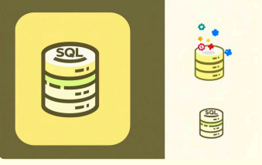


Tool & Technology Stack
Our solution is built on a robust, open-source technology stack, ensuring flexibility, cost-effectiveness, and scalability
Python
Core language for AI/ML and scripting.
SQL
For efficient data management and storage.
Scikit-learn
Fundamental machine learning algorithms.
Beautiful Soup / selenium
Powerful web scraping tools for data extraction.

Slide 8
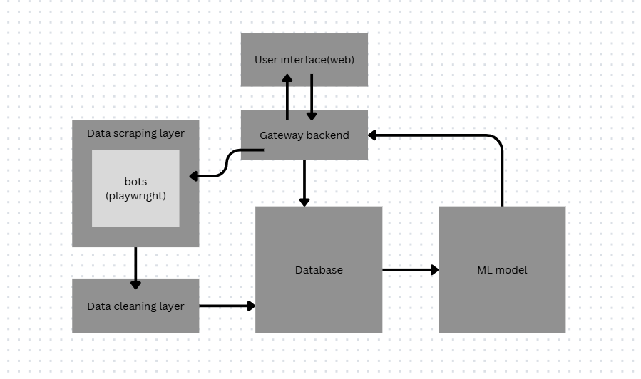
system architecture
selenium

Slide 9
Work done till now
Completed model training
Created web interface
Integrated Bots
Finalized the Project

Slide 10
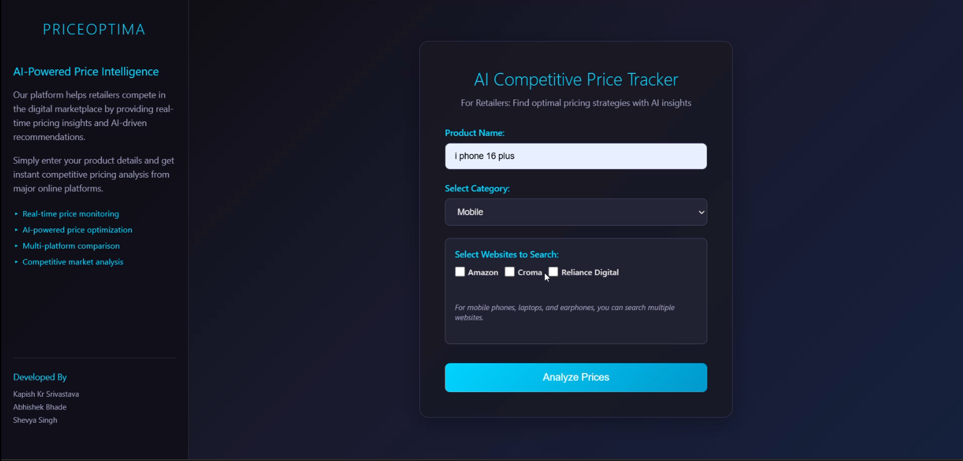
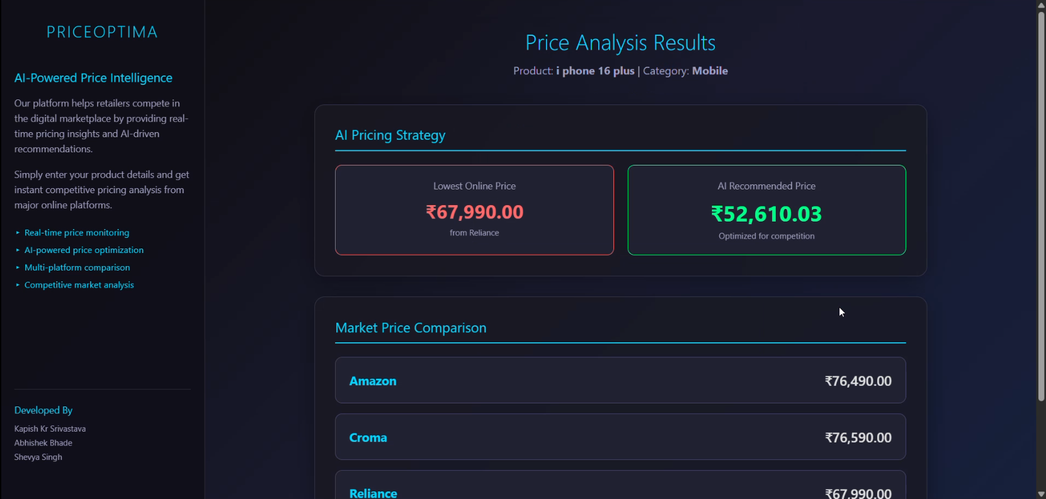
web interface

Slide 11
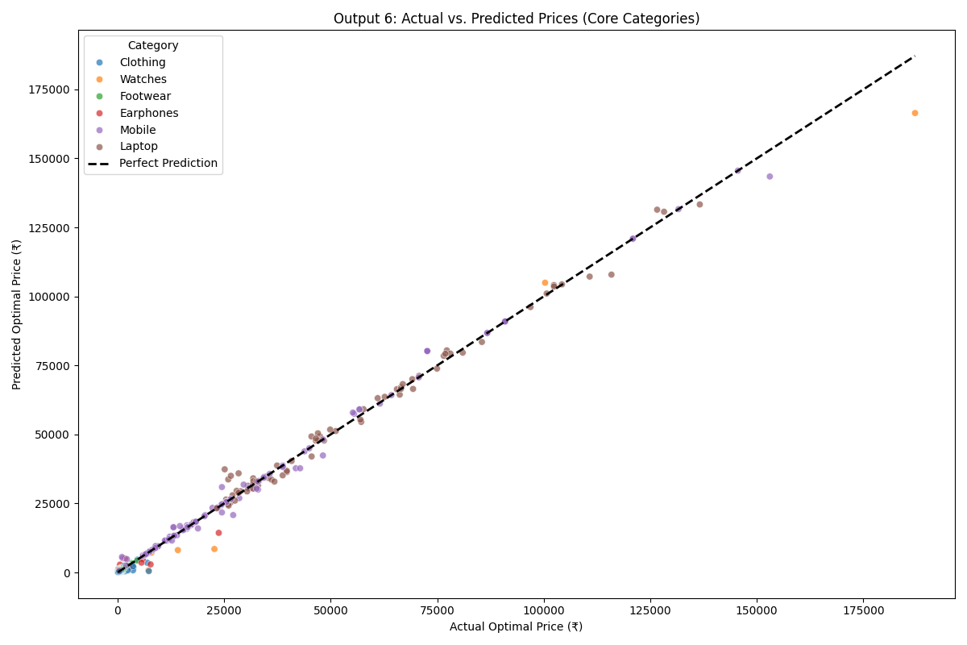
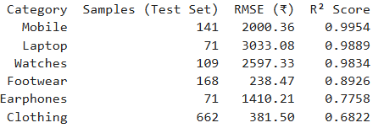
Results

Slide 12
Thank you

